Slide 1
DIFFERENTIAL EVOLUTION

Slide 2

DIFFERENTIAL EVOLUTION
Combinatorial optimization algorithm
evolutionary computing
Similar to GA in metaphor
Suitable for real-valued vector problems
Mutation and recombination are done in one step
This variation generation step is done by arithmetically combining the vectors representing the solutions

Slide 3
GA vs DE: generating variation
Genetic Algorithm
Population generation
Selection
Crossing over
Mutation
Differential evolution
Population generation
Mutation/crossing over in a single as a single step
Selection is based on the comparison between the mutated vector and the original vector

Slide 4
HYPERPARAMETERS
HYPERPARAMETERS
CR = Crossover Probability
F = Differential weight
NP = Population size
CR = 0.7
CR = 0.3

Slide 5
HYPERPARAMETERS
HYPERPARAMETERS
CR = Crossover Probability
F = Differential weight
NP = Population size
F = 0.8
F = 1.5

Slide 6
HYPERPARAMETERS
HYPERPARAMETERS
CR = Crossover probability
F = Differential weight
NP = Population size
NP = 5
NP = 7

Slide 7
GENERAL STRUCTURE OF THE ALGORITHM
Random Generation of solution
Size: n10
For each vector, choose other three
a
b
x
c
e
d
Generate a trial vector from vector A
f
g
h
i
If the trial vector has a better fitness than the parental vector, it replaces the parental vector in the population

Slide 8
GENERAL STRUCTURE OF THE ALGORITHM
Random Generation of solution
Size: n10
a
b
x
For each vector, choose other three
c
e
d
f
Generate a trial vector from vector A
g
h
i
If the trial vector has a better fitness than the parental vector, it replaces the parental vector in the population

Slide 9
GENERAL STRUCTURE OF THE ALGORITHM
Random Generation of solution
Size: n10
For each vector, choose other three
a
x
b
c
Generate a trial vector from vector A
e
d
f
g
h
i
If the trial vector has a better fitness than the parental vector, it replaces the parental vector in the population

Slide 10
GENERAL STRUCTURE OF THE ALGORITHM
Random Generation of solution
Size: n10
For each vector, choose other three
a
x
b
c
Generate a trial vector from vector A
e
d
f
g
h
i
If the trial vector has a better fitness than the parental vector, it replaces the parental vector in the population

Slide 11
GENERATING A NEW VECTOR
x
Parental vector
Trial vector
1
2
X₊₁= [X,X,X,X,X]
c
1 2 3 4 5
d
e
b
x = [3,4,3,1,7]
a
For each of these positions (X_{i})
f
g
a = [1,2,2,9,6]
1. Generate a random number (from 0 to 1) - R
h
b = [8,2,1,1,7]
c = [3,4,5,1,9]
2a. If R < CR
(that is, if R for < CR):
2b. If the number is not < CR:
Hyperparameters
F = 0.8
CR = 0.2
Npop = 10
Formula A - X_{i+1} = ai + F * (bi - ci)
X_{i+1} = X_{i}

Slide 12
GENERATING A NEW VECTOR
Hyperparameters
F = 0.8
CR = 0.2
Npop = 10
Trial vector x+1
2a. If the number is < CR
(that is, if R < CR):
2b. If the number < CR:
X₊₁= [X,X,X,X,X]
X₊₁= [3,X,X,X,X]
Formula A - X+1₀ = a₀ + F * (b₀ – c₀)
Parental vector X
X+1₀ = X₀
x = [3,4,3,1,7]
R = 0.34
a = [1,2,2,9,6]
b = [8,2,1,8,1]
c = [3,4,5,1,9]

Slide 13
GENERATING A NEW VECTOR
Hyperparameters
F = 0.8
CR = 0.2
Npop = 10
2a. If the number is < CR
(that is, if R < CR):
2b. If the number < CR :
Trial vector x+1
X₊₁= [3,0.4,X,X,X]
X₊₁= [3,X,X,X,X]
Formula – X+1₁= a₁ + F * (b₁ – c₁)
Parental vector X
x = [3,4,3,1,7]
X+1₁ = X₁
R = 0.14
a = [1,2,2,9,6]
b = [8,2,1,8,1]
X+1₁ = 2 + 0.8 * (2 - 4)
c = [3,4,5,1,9]
X+1₁= 0.4

Slide 14
GENERATING A NEW VECTOR
Hyperparameters
F = 0.8
CR = 0.2
Npop = 10
2a. If the number is < CR
(that is, if R < CR):
2b. If the number < CR :
Trial vector x+1
X₊₁= [3,0.4,X,X,X]
Formula A – X+1₂= ai + F * (b₂ – c₂)
X₊₁= [3,0.4,3,X,X]
Parental vector X
X+1₂= X₂
x = [3,4,3,1,7]
R = 0.6
a = [1,2,2,9,6]
b = [8,2,1,8,1]
c = [3,4,5,1,9]

Slide 15
GENERATING A NEW VECTOR
Hyperparameters
F = 0.8
CR = 0.2
Npop = 10
Trial vector x+1
2a. If the number is < CR
(that is, if R < CR):
2b. If the number < CR :
X₊₁= [3,0.4,3,1,X]
Formula A – X+1₃= a₃ + F * (b₃ – c₃)
X₊₁= [3,0.4,3,X,X]
Parental vector X
x = [3,4,3,1,7]
X+1₃= X₃
a = [1,2,2,9,6]
R = 0.23
b = [8,2,1,8,1]
c = [3,4,5,1,9]

Slide 16
GENERATING A NEW VECTOR
Hyperparameters
F = 0.8
CR = 0.2
Npop = 10
2a. If the number is < CR
(that is, if R < CR):
2b. If the number < CR :
Trial vector x+1
X₊₁= [3,0.4,3,1,X]
Formula – X+1₄ = a₄ + F * (b₄ – c₄)
X₊₁= [3,0.4,3,1,7]
Parental vector X
X+1₄= X₄
x = [3,4,3,1,7]
R = 0.54
a = [1,2,2,9,6]
b = [8,2,1,8,1]
c = [3,4,5,1,9]

Slide 17
GENERATING A NEW VECTOR
If trial vector better than parental vector:
Replace parental vector by trial vector
If trial vector worse than parental vector:
Do nothing
3
Parental vector
x
X = [3,4,3,1,7]
Trial vector
X₊₁
x
X₊₁= [3,0.4,3,1,7]
X₊₁
d
c
b
e
a
g
f
h

Slide 18
GENERATING A NEW VECTOR
Random Generation of solution
Size: n10
For each vector, choose other three
a
b
x
Generate a trial vector from vector A
c
e
d
f
g
h
i
If the trial vector has a better fitness than the parental vector, it replaces the parental vector in the population

Slide 19
GENERATING A NEW VECTOR
Set hyperparameters
Np = population size
CR = mutation/crossover probability
F = differential weight
Initialize the population of solution vectors
For each number from 1 to num:
For each solution vector X in the population:
Create an updated empty vector X+1
Choose three other vectors a, b, and c different from each other and different from X
For each index Xi in X:
generate a random value R from 0 to 1:
if R < CR:
X+1i = ai + F*(bi – ci)
if R >= CR:
X+1i = Xi
If fitness value of X+1 >= fitness value of X:
replace X with X+1 in the population
If fitness value of X+1 < fitness value of X:
Do not replace X in the population

Slide 20
GENERATING A NEW VECTOR
a
b
c
d
e
f
g
h
i
x
b
x
b
b
b
e
b
b
x
b
c
c
a
c
c
g
c
a
c
a
d
d
d
f
d
d
h
d
d
c
A’
B’
C’
D’
E’
F’
G’
H’
I’
X’

Slide 21
GA vs DE: OPERATORS
Genetic algorithms
Differential evolution
Crossing over
X
A
B
C

Slide 22
GA vs DE: OPERATORS
Genetic algorithms
Differential evolution
Mutation
X
A
B
C
X’

Slide 23
GA vs DE: OPERATORS: SELECTION
Genetic algorithms
Differential evolution
new

Slide 24
CASE STUDY – NUTRIENT ALLOCATION
Objective function:
Carbohydrate sum:
Difference from 55
Protein sum:
Difference from 30
Lipid sum:
Difference from 15
Sum of the three differences: goal is to get to zero (minimization)
Suppose that in a given meal, a 500g meal should contain 30% protein, 15% fat, and carbohydrates.
The food options are:
Chicken breast: 23 g protein; 5 fat; 5 of carbohydrate
Sweet potato: 24g of carbohydrate; 0 fat; 2g of protein
Brown rice: 2.6g of protein; 26g of carbohydrate; 1g of fat
Egg: 13g of protein; 8.9g of lipids; 1.5g of carbohydrates
Beans: 9.5g of protein; 1.4g of fat; 29g of carbohydrates
Objective: Determine what combination of amounts of these 5 foods results in 30% protein, 15% fat, 55% carbohydrates, and 400 g total

Slide 25
OBJECTIVE FUNCTION
Objective function:
Carb sum:
Difference from 55
Prot sum:
Difference from 30
Lipid sum:
Difference from 15
Sum of 3 differences: goal is to get to zero (minimization)
The dish/meal should have approximately 30% protein, 15% lipids, and 55% carbohydrates.
((Sum of carbohydrate in all foods/Sum of all nutrients in all foods)*100) – 55)*abs
((Sum of protein in all foods/Sum of all nutrients in all foods)*100) – 30)*abs
((Sum of lipid in all foods/sum of all nutrients in all foods)*100) – 15)*abs
+
+

Slide 26
POPULATION
Population
P2
a
b
a
b
e
e
c
c
d
d
parental
f
f
Three_vectors
a
e
d

Slide 27
ARTIFICIAL IMMUNE SYSTEM

Slide 28
ARTIFICIAL IMMUNE SYSTEM
Class of algorithms inspired by the vertebrate immune system
4 algorithms are most discussed in this class
1. Clonal selection algorithm
2. Negative selection algorithm
3. Algorithms based on immune cell networks
4. Dendritic cell algorithms

Slide 29
CLONAL SELECTION AND IMMUNE SYSTEM
Similar to the process of Darwinian evolution that occurs with populations of individuals
Maturation of antibody and T cell receptor response to foreign antigens
Combined and successive processes of hypermutation and selection of antibodies and their respective cells refine their recognition by the antigen
Main applications:
1- Classification
2- Pattern detection
3-Anomaly detection
4- Information security
5-Optimization of mathematical functions

Slide 30
CLONAL SELECTION AND IMMUNE SYSTEM
Antigen
B lymphocytes

Slide 31
CLONAL SELECTION AND IMMUNE SYSTEM
Memory cells
Memory cells
Plasmocytes

Slide 32
ANTIBODY AFFINITY AND SELECTION
affinity
60%
80%
affinity

Slide 33
AFFINITY AND SELECTION OF ANTIBODIES
55
60
80
70
70
0.16
0.17
0.24
0.21
0.21
8 clones
8 clones
12 clones
11 clones
11 clones
Sum: 335
Antibody population: 50

Slide 34
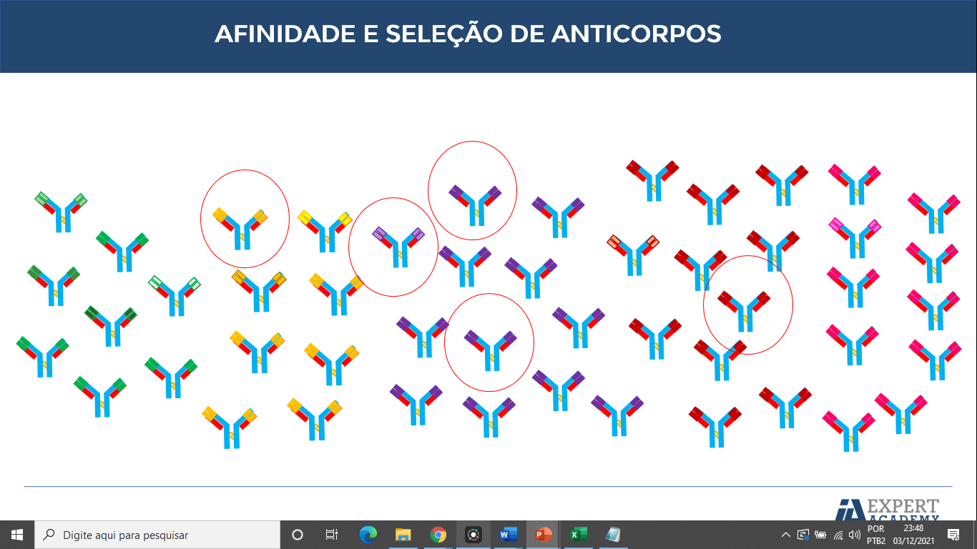
HYPERMUTATION

Slide 35
GENERAL STRUCTURE - CSA
Generation of antibody population
Selection of the antibodies with most affinity
Cloning of the most promising antobidies
Hypermutation of the antibodies according to the affinity

Slide 36
GENERAL STRUCTURE - CSA
General structure of the algorithm
Generation of the antibody population
Set the fitness function
For every i from 1 to n:
For each antibody:
Calculate fitness for each antibody
Select the n best antibodies
For each antibody selected:
perform cloning proportionally to affinity
perform hypermutation inversely proportional to affinity

Slide 37
APPLICATION – DIGIT RECOGNITION
Objective: To recognize the digit in the right, represented by pixels
Antigen
The figure with the number 8 in pixels (problem antigen) is represented by a vector or list with several values of 0’s and 1’s, just like the antigens (11x11)
[0,0,0,0,1,0,0,1 ... 0,1,1,0,0]
1
121

Slide 38
APPLICATION – DIGIT RECOGNITION
Antibody
Antigen

Slide 39
APPLICATION – DIGIT RECOGNITION
Antibody
Antobody maturation
Matured antibody = Antigen recognition

Slide 40
OBJETIVE FUNCTION: AFFINITY
Antibody
Antigen
Affinity =
0
1
Max afinity value: 121

Slide 41
CLONING THE BEST ANTIBODIES
New antibodies
Best antibodies
Worst antibodies
15 antibodies remaining
Total: 20

Slide 42
CLONING THE BEST ANTIBODIES
Best antibodies
New antibodies
Best antibodies
Worst antibodies
15 antibodies left
Total: 20

Slide 43
CLONING THE BEST ANTIBODIES
Best antibodies
New antibodies
Total: 20

Slide 44
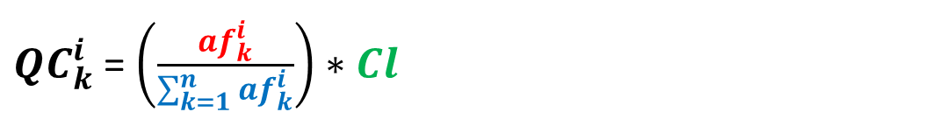
CLONING RATE FOR EACH ANTIBODY

Slide 45
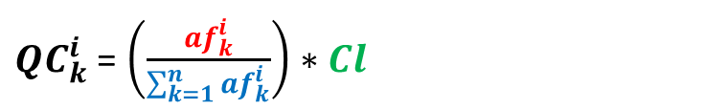


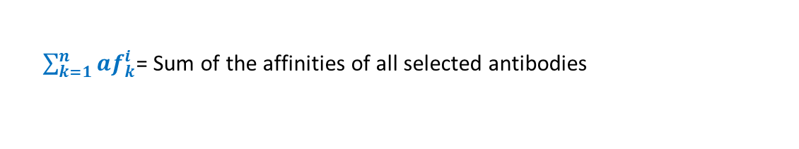
CLONING RATE FOR EACH ANTIBODY
Total antibodies: 20
Selected: 3
Generated clones: 17
Afin antibody 1: 80
Afin antibody 2: 72
Afin antibody 3: 98
56
25
56+67+88

Slide 46
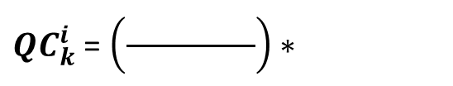

CLONING RATE FOR EACH ANTIBODY
Total antibodies: 20
Selected: 3
Generated clones: 17
Afin antibody 1: 80
Afin antibody 2: 72
Afin antibody 3: 98
72
17
80+72+98

Slide 47
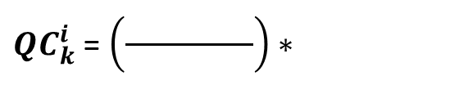

CLONING RATE FOR EACH ANTIBODY
Total antibodies: 20
Selected: 3
Generated clones: 17
Afin antibody 1: 80
Afin antibody 2: 72
Afin antibody 3: 98
98
17
80+72+98

Slide 48
CLONING RATE FOR EACH ANTIBODY
New antibodies (3)
Antobody 1(5)
Antobody 2(5)
Antibody 3(7)
Worst antibodies
Best antibodies

Slide 49
ANTIBODY HYPERMUTATION
Antibody with 60% affinity
Antibody with 80% affinity
Antigen

Slide 50


HYPERMUTATION - CALCULATION
Affinity = 79
β = 0.1
β = mutation factor – may be 0.1; 1; 10 etc
0.0347
0.0347
[0,0,1,0,1,0,1...,0,0,1,0]
0.0347

Slide 51



HYPERMUTATION - CALCULATION
Exemple 2
Affinity = 110
β = 0.1
β = mutation factor – may be 0.1; 1; 10 etc
0.009
0.009
[0,0,1,0,1,0,1...,0,0,1,0]
0.009

Slide 52
PARTICLE SWARM OPTIMIZATION (PSO)

Slide 53
PSO - INTRODUCTION
Main applications
1. Animations that simulate animal behavior
2. Scientific and engineering problems
Design of antenas
Optimization of energy systems
3. Optimization of mathematical functions
Mainly non-linear, continuous functions
Heuristic based on the collecive behavior of animals
1. Bird flocks
2. Insect swarms
Proposed by Kennedy, and Eberhart in the 90’s, inspired in the studies that modelled the social behavior of animals

Slide 54

PSO – BIRD FLOCK

Slide 55
PSO – BIRD FLOCK

Slide 56
PSO – BIRD FLOCK
Animal inertia
Next direction

Slide 57
PSO - EXAMPLE
Person
Closest person
Heat source

Slide 58
PSO - EXAMPLE
Person
Closest person
Heat source

Slide 59
PSO - EXAMPLE
Person
Closest person
Heat source

Slide 60
PSO - EXAMPLE
Person
Closest person
Heat source

Slide 61
PSO – BIRD CRANE

Slide 62
PSO – BIRD CRANE

Slide 63
PSO – NO INERTIA

Slide 64
PSO – PARTICLES

Slide 65
PSO – WITH INERTIA

Slide 66
PSO – NO INERTIA

Slide 67
PSO – WITH INERTIA

Slide 68
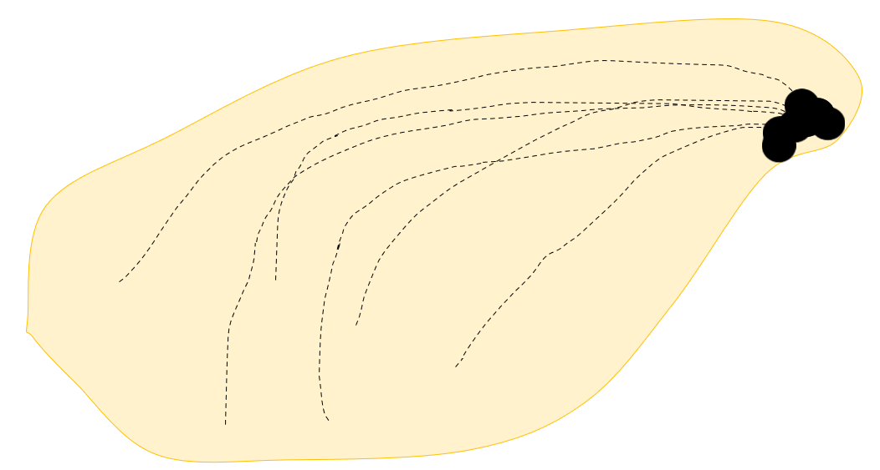
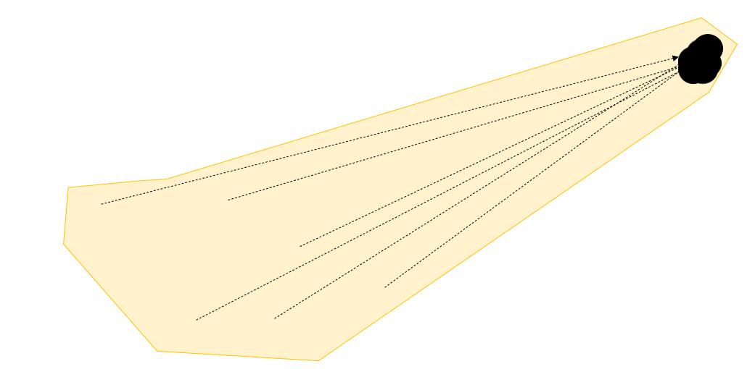
COMPARISON – WITH/WITHOUT INERTIA
No inertia
Inertia
More efficient search in the search space

Slide 69
PSO ALGORITHM – MAIN STEPS
1. Initilize the population with random values
2. Evaluate the fitness of every particle
3. Compare the value of each particle position with its anterior position (find the pbest)
Repeat until a stopping criterion is met
4. Compare the value of each particle in the population (find the gbest)
5. Update velocity and position of every particle

Slide 70
PSO ALGORITHM – DETAILED STEPS
Determine the fitness function
Determination of hyperparameters
-inertia
-c1
-c2
Initialize the particle population with each respective position
ITERATIONS (set the number of iterations)
For each particle, evaluate the best position:
If current position > best position, then:
best position = current position
For the particle set:
If particle position > best global position:
best overall position = particle position
Update the position of each particle
New velocity = inertia x velocity + c1xr1(best individual position – previous position) + c2xr2(best overall position – previous position)
New position = previous position + new speed

Slide 71
PSO ALGORITHM - PARTICLE
pos1
pos2
vel
Function : x² + y²
[21,32]
[28,15]
[0,0]
2 variables (x and y), therefore, we have two dimensions
Each particle is composed of three pieces of information: the previous position (or pos1), current position (or pos2) and the velocity (vel)
The positions of each particle will be vectors whose size can vary depending on the dimensionality of the problem.

Slide 72
PSO ALGORITHM – INITIALIZING THE POPULATION
pos1
pos2
vel
[11,32]
[22,15]
[0,0]
[0,0]
[21,32]
[28,15]
[0,0]
[11, 2]
[28,65]
[1,38]
[23,11]
[0,0]
[41,52]
[68,45]
[0,0]

Slide 73
PSO ALGORITHM – BEST PERSONAL POSITION
pbest
[11,32]
[22,15]
[0,0]
pbest
pbest
[0,0]
[21,32]
[28,15]
[0,0]
[11, 2]
[28,65]
pbest
pbest
[1,38]
[23,11]
[0,0]
[41,52]
[68,45]
[0,0]

Slide 74
PSO ALGORITHM – BEST GLOBAL POSITION
pbests
pbest
[11,32]
[28,15]
[11,2]
[1,38]
[41,52]
[11,32]
[22,15]
[0,0]
gbest
pbest
pbest
[0,0]
[21,32]
[28,15]
[0,0]
[11, 2]
[28,65]
pbest
pbest
[1,38]
[23,11]
[0,0]
[41,52]
[68,45]
[0,0]

Slide 75

PSO ALGORITHM – UPDATE OF POSITION AND VELOCITY OF THE PARTICLES
New position
=
Current position
+
New velocity
pbest
[11,32]
[22,15]
[0,0]
pbest
pbest
gbest
[0,0]
[21,32]
[28,15]
[0,0]
[11, 2]
[28,65]
[1,38]
pbest
pbest
[1,38]
[23,11]
[0,0]
[41,52]
[68,45]
[0,0]

Slide 76
PSO ALGORITHM – UPDATE OF POSITION AND VELOCITY OF THE PARTICLES
Variable | Meaning
 | Cognitive weight (from 0 to 2)
 | Social weight (from 0 to 2)
 | Random numbers (0 to 1)
 | Inertia
 | Personal best position
 | Global best position
 | Current particle position
 | New position
 | New velocity
New position
=
Current position
+
New velocity

Slide 77

PARTICLE POSITION UPDATE - EXAMPLE
New position
=
Current position
+
New velocity
pbest
[11,32]
[22,15]
[0,0]
pos1
pos2
vel
New position
=
Current position
+
New velocity
gbest
w = 0.8
c1 = 0.5
c2 = 0.5
r1 = 0.3
r2 = 0.45
New pos = [22,15] + new vel.
[1,38]
New vel = inertia*[0,0] +c1*r1*([11,32] – [22,15]) + c2*r2([1,38] – [22,15])
New vel = [-7.475, 9.425]
New pos = [-7.475, 9.425] + [22,15] = [14.525, 24.425]

Slide 78


PARTICLE POSITION UPDATE - EXAMPLE
(Current position)
New pos = [22,15] + new vel.
[11,32]
[22,15]
[0,0]
New vel = inertia*[0,0] +c1*r1*([11,32] – [22,15]) + c2*r2([1,38] – [22,15])
pos1
pos2
vel
New vel = [-7.475, 9.425]
New pos = [-7.475, 9.425] + [22,15] = [14.525, 24.425]
[22,15]
[14.525, 41.425]
[-7.47, 9.42]
pos1
pos2
vel
(New position)

Slide 79

















GRAPHICAL/VECTORIAL REPRESENTATION OF VELOCITY/POSITION UPDATE
Current particle velocity
Particle memory
Swarm influence

Slide 80









GRAPHICAL/VECTORIAL REPRESENTATION OF VELOCITY/POSITION UPDATE
Current particle velocity
Particle memory
Swarm influence

Slide 81

















GRAPHICAL/VECTORIAL REPRESENTATION OF VELOCITY/POSITION UPDATE

Slide 82
CASE STUDY: TIME ALLOCATION PROBLEM
Class 1:
Has 3 hours available in the morning of Monday
Has 2 hours available in the afternoon of monday
Has 1 hours available in the morning of Tuesday
Has 2 hours available in the afternoon of Tuesday
Has 3 hours available in the morning of Wednesday
Has 2.5 hours available in the afternoon of Wednesday
A course will be ministered on the Monday, Tuesday and Wednesday of a specific week. The course has 13 hours in total.
3 classes are interested in enrolling in the course, but here is a problem: They have different time schedules available for the course
Class 2:
Has 1 hours available in the morning of Monday
Has 4 hours available in the afternoon of monday
Has 0 hours available in the morning of Tuesday
Has 3 hours available in the afternoon of Tuesday
Has 4 hours available in the morning of Wednesday
Has 1.5 hours available in the afternoon of Wednesday
Question: How can one distribute the hours of the course (13h) among Monday, Tuesday, and Wednesday (both turns – 6 turns), in such a way that optimizes the use of the course by the 3 classes
MM: Monday Morning
MA: Monday Afternoon
TM: Tuesday Morning
TA: Tuesday Afternoon
WM: Wednesday Morning
WA: Wednesday Afternoon
Class 3:
Has 2.5 hours available in the morning of Monday
Has 3.5 hours available in the afternoon of Monday
Has 1 hours available in the morning of Tuesday
Has 2.5 hours available in the afternoon of Tuesday
Has 3.5 hours available in the morning of Wednesday
Has 1.5 hours available in the afternoon of Wednesday

Slide 83
OBJECTIVE FUNCTION
Objective function of the problem
Score of class 1 = (score of MM+ score of MA) + (score of TM + score of TA) + (score of WM + score of WA)
Score of class 2 = (score of MM+ score of MA) + (score of TM + score of TA) + (score of WM + score of WA)
Score of class 3 = (score of MM+ score of MA) + (score of TM + score of TA) + (score of WM + score of WA)
Overall score = (score of class1 + score of class 2 + score of class 3)/39
A number from 0 to 1 will be generated
Example:
Total score = [11 (class 1) + 8 (class 2) + 9 (class 3)]/39 = 28/39

Slide 84
EXAMPLE OF A CANDIDATE SOLUTION
Class 1:
Has 3 hours available in MM
Has 2 hours available in MA
Has 1 hours available in TM
Has 2 hours available in TA
Has 3 hours available in WM
Has 2.5 hours available in WA
Example of Candidate solution
MM
TM
WM
2
2
3
Total score (3 classes): 31h
Total score: 31/39 ~ 0.79
Class 2:
Has 1 hours available in MM
Has 4 hours available in MA
Has 0 hours available in TM
Has 3 hours available in TA
Has 4 hours available in WM
Has 1.5 hours available in WA
MA
TA
WA
2
2
2
Score of class 1
MM: 2
MA: 2
TM: 1
TA: 2
WM: 3
WA: 2
Total: 12h
Score of class 2
MM: 1
MA: 2
TM: 0
TA: 2
WM: 2
WA: 1.5
Total: 8.5h
Score of class 3
MM: 2
MA: 2
TM: 1
TA: 2
WM: 3
WA: 1.5
Total: 10.5h
Class 3:
Has 2.5 hours available in MM
Has 3.5 hours available in MA
Has 1 hours available in TM
Has 2.5 hours available in TA
Has 3.5 hours available in WM
Has 1.5 hours available in WA

Slide 85
REPRESENTATION OF THE SOLUTION AS VECTORS/PARTICLES
pos1
pos2
vel
[1,3,2,4,3.5,2]
[1,1.5,2,2.5,3,2]
[0,0,0,0,0,0]
6 dimensions
MM
MA
TM
TA
WM
WA

Slide 86
ANT COLONY OPTIMIZATION (ACO)

Slide 87
ANT COLONY OPTIMIZATION (ACO)
Ant Colony Optimization (ACO)
Applications
Algorithm proposed by Dorigo, in 1992
1.Internet routing
2.GPS systems
3.Edge detection in images
It is based on the foraging behavior of ants in search for food
Ants communicate with pheromones, and they tend to follow pheromone trails (stygmergy)
Pheromone evaporates with time

Slide 88

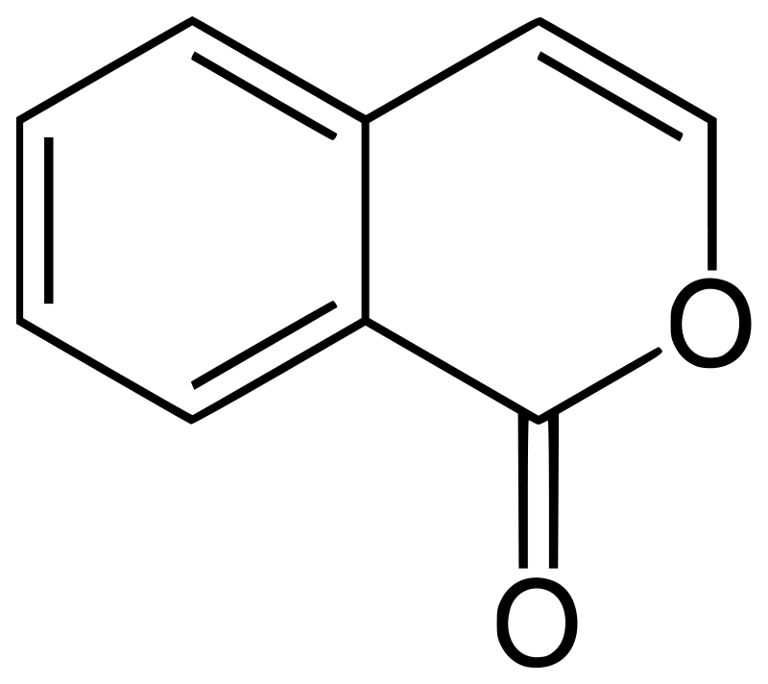
PHEROMONE RELEASE

Slide 89
PHEROMONE EVAPORATION

Slide 90
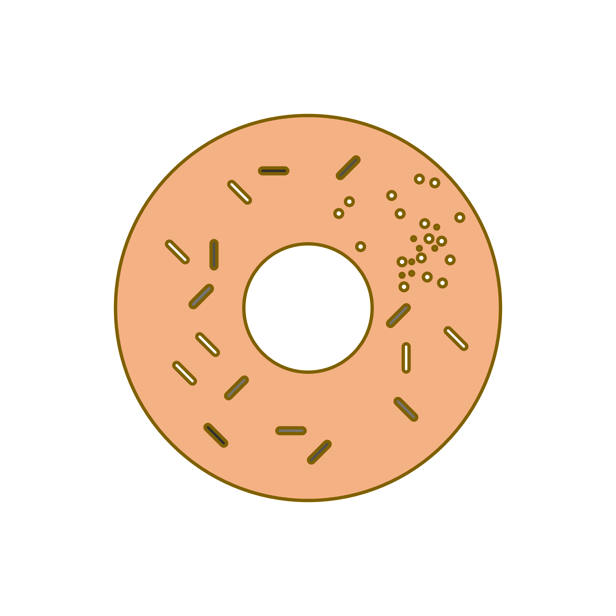
FOOD FORAGING BEHAVIOR
Food

Slide 91
FOOD FORAGING BEHAVIOR

Slide 92
FOOD FORAGING BEHAVIOR
Food

Slide 93
FOOD FORAGING BEHAVIOR
Food

Slide 94
FOOD FORAGING BEHAVIOR
Food

Slide 95
ANT COLONY OPTIMIZATION (ACO)
Food

Slide 96
PHEROMONE CONCENTRATION AS A SHORTCUT

Slide 97
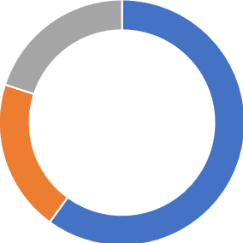
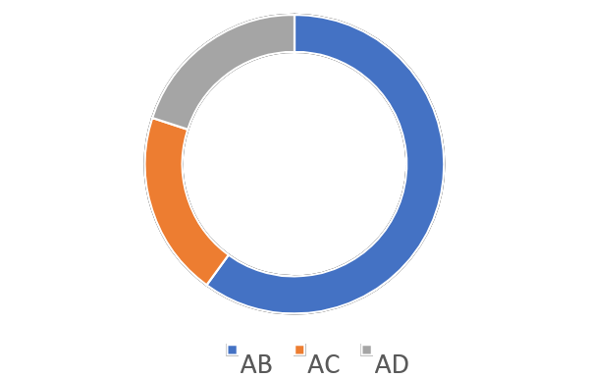
ROULLETE WHEEL TECHNIQUE
[AB,AC,AD]
[0.6,0.2,0.2]
AB: 0.6
AC: 0.2
AD: 0.2
0.6
0.2
0.2
0
0.6
0.8
1
count = 0
If R < 0.6: count = 0
If R < 0.8: count = 1
If R > 0.8: count = 2
R = 0.34
Index [0]
[AB,AC,AD]
[0.6,0.2,0.2]

Slide 98
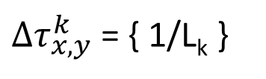
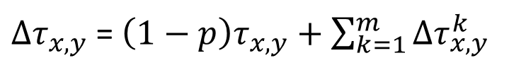
PHEROMONE UPDATE
K = ant
x,y = edge from x to y
L_{k} = length of the path
Current level of pheromone deposited
Evap. constant
Pheromone to the added

Slide 99
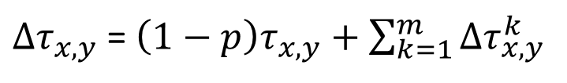

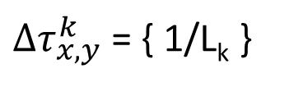

PHEROMONE UPDATE
m = n. of ants
Current level of pheromone deposited
5
5
4
9
Evap. constant
Pheromone to the added
3
3
In turn, the amount of pheromone deposited by a certain ant k on the path x,y is given by 1/Lk, that is, 1/length of the path
5
5
4
Const. Evaporation ρ: 0.3
9
3
3

Slide 100
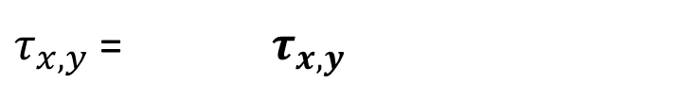

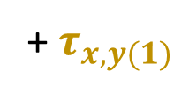

PHEROMONE UPDATE
1/10
1
*0,7
*0,7
+1/10+1/12
1/10
1
+1/10
5
4
5
5
5
4
1
*0,7
+1/12
9
*0,7
1
3
3
9
3
3
1
+1/12
*0,7
1
*0,7
1/12
5
4
1/12
5
9
1/12
3
3

Slide 101
PHEROMONE UPDATE
1
*0.7
*0.7
+1/10+1/12
1
+1/10
0.8333
5
0.8
5
5
4
1
5
*0.7
+1/12
4
0.78333
*0.7
1
0.7
9
9
3
3
1
+1/12
3
3
*0.7
1
*0.7
0.78333
0.7

Slide 102
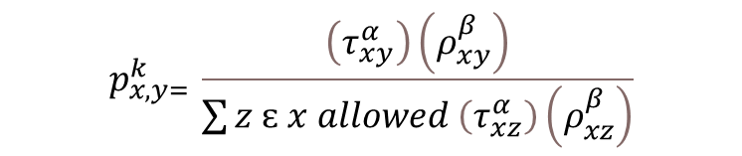


PROBABILITY OF EDGE SELECTION
z
Probability to choose the edge from point x to point y
x
y
z
= pheromone deposit
= path quality
(1/path length)
α and β are values greater than 0 that are used to control the influence of the pheromone deposit and the path distance. Most often they are set at 1.

Slide 103
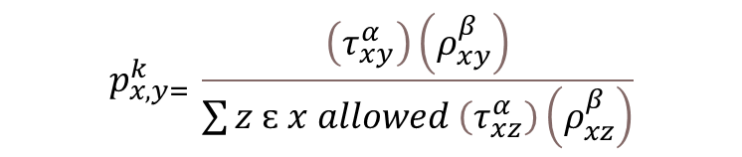


PROBABILITY OF EDGE SELECTION
1
1
1
1
1
1
= pheromone deposit
= path quality
5
5
4
9
3
3

Slide 104
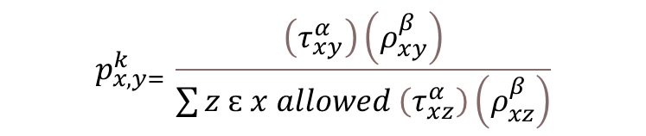
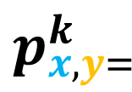


PROBABILITY OF EDGE SELECTION
(1) X (1/5)
0.31
(1) X (1/5)
+ (1) X (1/9)
+ (1) X (1/3)
= pheromone deposit
= path quality
1
1
1
1
1
1
0.31
5
5
4
9
3
3

Slide 105
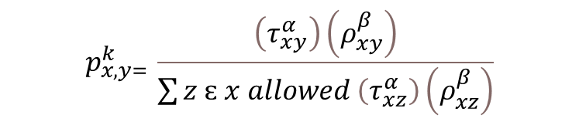
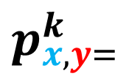


PROBABILITY OF EDGE SELECTION
(1) X (1/9)
0.17
(1) X (1/5)
+ (1) X (1/9)
+ (1) X (1/3)
= pheromone deposit
= path quality
1
1
1
1
1
1
0.31
0.17
5
5
4
9
3
3

Slide 106
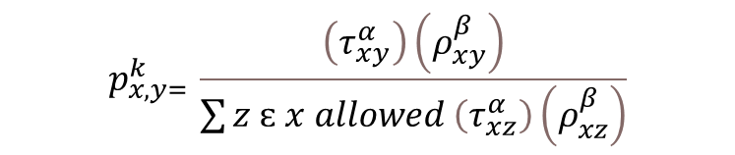
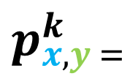


PROBABILITY OF EDGE SELECTION
(1) X (1/3)
0.51
(1) X (1/5)
+ (1) X (1/9)
+ (1) X (1/3)
= pheromone deposit
= path quality
1
1
1
1
1
1
0.31
0.17
5
5
4
9
0.51
3
3

Slide 107


B
Edges
AB: 1; 1; (BD, BC)
AD: 3; 1; (---)
AC: 1.5; 1; (CD)
BD: 1.5; 1; (AB, CD)
CD: 1.5; 1; (---)
BC: 2; 1; (AC, AB, BD, CD)
1
1.5
2
A
D
3
1.5
1.5
C

Slide 108
B
1 (1/1)
Edges
AB: 1; 1; (BD, BC)
AD: 3; 1; (---)
AC: 1.5; 1; (CD)
BD: 1.5; 1; (AB, CD)
CD: 1.5; 1; (---)
BC: 2; 1; (AC, AB, BD, CD)
0.66(1/1.5)
0.5 (1/2)
A
D
0.33 (1/3)
0.66 (1/1.5)
0.66 (1/1.5)
C

Slide 109
B
1 (1/1)
Edges
AB: 1; 1; (BD, BC)
AD: 3; 1; (---)
AC: 1.5; 1; (CD)
BD: 1.5; 1; (AB, CD)
CD: 1.5; 1; (---)
BC: 2; 1; (AC, AB, BD, CD)
0.66(1/1.5)
0.5 (1/2)
A
D
0.33 (1/3)
0.66 (1/1.5)
0.66 (1/1.5)
C

Slide 110
B
1 (1/1)
Edges
AB: 1; 1; (BD, BC)
AD: 3; 1; (---)
AC: 1.5; 1; (CD)
BD: 1.5; 1; (AB, CD)
CD: 1.5; 1; (---)
BC: 2; 1; (AC, AB, BD, CD)
0.66(1/1.5)
0.5 (1/2)
A
D
0.33 (1/3)
0.66 (1/1.5)
0.66 (1/1.5)
C

Slide 111
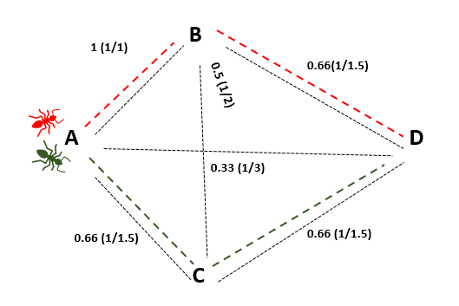
2 Ants
AB,BD
Path length: 2.5
Pheromone deposited: 1/2.5 (0.4)
AC, CD
Path length : 3
Pheromone deposited : 1/3 (0.33)
Edges
AB: 1; 1; (BD, BC)
AD: 3; 1; (---)
AC: 1.5; 1; (CD)
BD: 1.5; 1; (AB, CD)
CD: 1.5; 1; (---)
BC: 2; 1; (AC, AB, BD, CD)
Edges
AB: 1; 0.7*1+0.4; (BD, BC)
AD: 3; 0.7*1; (---)
AC: 1.5; 0.7*1+0.33; (CD)
BD: 1.5; 0.7*1+0.4 (AB, CD)
CD: 1.5; 0.7*1+0.33; (---)
BC: 2; 0.7*1; (AC, AB, BD, CD)
Edges
AB: 1; 1.1; (BD, BC)
AD: 3; 0.7; (---)
AC: 1.5; 1.033; (CD)
BD: 1.5; 1.1; (AB, CD)
CD: 1.5; 1.033; (---)
BC: 2; 0.7; (AC, AB, BD, CD)

Slide 112
B
1.1 (1.1/1)
0.73(1.1/1.5)
Edges
AB: 1; 1.1; (BD, BC)
AD: 3; 0.7; (---)
AC: 1.5; 1.033; (CD)
BD: 1.5; 1.1; (AB, CD)
CD: 1.5; 1.033; (---)
BC: 2; 0.7; (AC, AB, BD, CD)
0.35 (0.7/2)
A
D
0.23 (0.7/3)
0.68 (1.033/1.5)
0.68 (1.033/1.5)
C

Slide 113
B
1.1 (1.1/1)
0.73(1.1/1.5)
Edges
AB: 1; 1.1; (BD, BC)
AD: 3; 0.7; (---)
AC: 1.5; 1.033; (CD)
BD: 1.5; 1.1; (AB, CD)
CD: 1.5; 1.033; (---)
BC: 2; 0.7; (AC, AB, BD, CD)
0.35 (0.7/2)
A
D
0.23 (0.7/3)
0.68 (1.033/1.5)
0.68 (1.033/1.5)
C

Slide 114
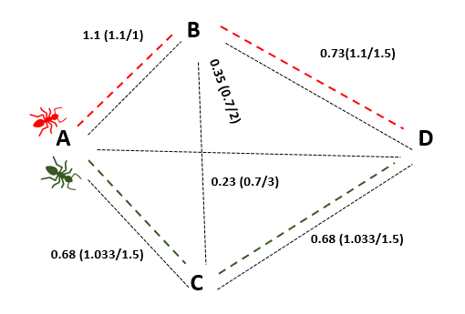
2 Ants
AB,BD
Path length: 2.5
Pheromone deposited: 1/2.5 (0.4)
AB, CD
Path length : 3
Pheromone deposited : 1/3 (0.33)
Edges
AB: 1; 1.1; (BD, BC)
AD: 3; 0.7; (---)
AC: 1.5; 1.033; (CD)
BD: 1.5; 1.1; (AB, CD)
CD: 1.5; 1.033; (---)
BC: 2; 0.7; (AC, AB, BD, CD)
Edges
AB: 1; 0.7*1.1+0.4; (BD, BC)
AD: 3; 0.7*0.7; (---)
AC: 1.5; 0.7*1.033+0.33; (CD)
BD: 1.5; 0.7*1.1+0.4 (AB, CD)
CD: 1.5; 0.7*1.033+0.33; (---)
BC: 2; 0.7*0.7; (AC, AB, BD, CD)
Edges
AB: 1; 1.17; (BD, BC)
AD: 3; 0.49; (---)
AC: 1.5; 1.05; (CD)
BD: 1.5; 1.17 (AB, CD)
CD: 1.5; 1.05; (---)
BC: 2; 0.49; (AC, AB, BD, CD)

Slide 115
B
1.17 (1.17/1)
0.78(1.17/1.5)
Edges
AB: 1; 1.17; (BD, BC)
AD: 3; 0.49; (---)
AC: 1.5; 1.05; (CD)
BD: 1.5; 1.17 (AB, CD)
CD: 1.5; 1.05; (---)
BC: 2; 0.49; (AC, AB, BD, CD)
0.24 (0.49/2)
A
D
0.16 (0.49/3)
0.7 (1.05/1.5)
0.7 (1.05/1.5)
C

Slide 116
B
1.17 (1.17/1)
0.78(1.17/1.5)
Edges
AB: 1; 1.17; (BD, BC)
AD: 3; 0.49; (---)
AC: 1.5; 1.05; (CD)
BD: 1.5; 1.17 (AB, CD)
CD: 1.5; 1.05; (---)
BC: 2; 0.49; (AC, AB, BD, CD)
0.24 (0.49/2)
A
D
0.16 (0.49/3)
0.7 (1.05/1.5)
0.7 (1.05/1.5)
C

Slide 117
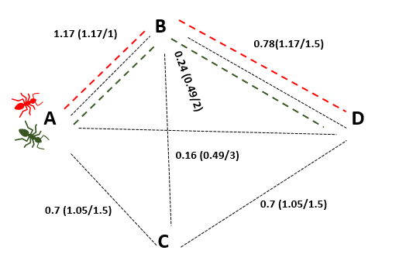
2 Ants
AB,BD
Path length: 2.5
Pheromone deposition: 1/2.5 (0.4)
AB, BD
Path length : 2.5
Pheromone deposition: 1/2.5 (0.4)
Edges
AB: 1; 1.17; (BD, BC)
AD: 3; 0.49; (---)
AC: 1.5; 1.05; (CD)
BD: 1.5; 1.17 (AB, CD)
CD: 1.5; 1.05; (---)
BC: 2; 0.49; (AC, AB, BD, CD)
Edges
AB: 1; 0.7*1.17+0.4+0.4; (BD, BC)
AD: 3; 0.7*0.49; (---)
AC: 1.5; 0.7*1.05; (CD)
BD: 1.5; 0.7*1.17+0.4+0.4 (AB, CD)
CD: 1.5; 0.7*1.05; (---)
BC: 2; 0.7*0.49; (AC, AB, BD, CD)
Edges
AB: 1; 1.62; (BD, BC)
AD: 3; 0.34; (---)
AC: 1.5; 0.73; (CD)
BD: 1.5; 1.62 (AB, CD)
CD: 1.5; 0.73; (---)
BC: 2; 0.34; (AC, AB, BD, CD)

Slide 118
B
1.62 (1.62/1)
1.08 (1.62/1.5)
Edges
AB: 1; 1.62; (BD, BC)
AD: 3; 0.34; (---)
AC: 1.5; 0.73; (CD)
BD: 1.5; 1.62 (AB, CD)
CD: 1.5; 0.73; (---)
BC: 2; 0.34; (AC, AB, BD, CD)
0.17(0.34/2)
A
D
0.11 (0.34/3)
0.48 (0.73/1.5)
0.48 (0.73/1.5)
C

Slide 119
B
1.62 (1.62/1)
1.08 (1.62/1.5)
Edges
AB: 1; 1.62; (BD, BC)
AD: 3; 0.34; (---)
AC: 1.5; 0.73; (CD)
BD: 1.5; 1.219 (AB, CD)
CD: 1.5; 1.535; (---)
BC: 2; 0.34; (AC, AB, BD, CD)
0.17(0.34/2)
A
D
0.11 (0.34/3)
0.48 (0.73/1.5)
0.48 (0.73/1.5)
C

Slide 120
B
1.62 (1.62/1)
1.08 (1.62/1.5)
Edges
AB: 1; 1.62; (BD, BC)
AD: 3; 0.34; (---)
AC: 1.5; 0.73; (CD)
BD: 1.5; 1.219 (AB, CD)
CD: 1.5; 1.535; (---)
BC: 2; 0.34; (AC, AB, BD, CD)
0.17(0.34/2)
A
D
0.11 (0.34/3)
0.48 (0.73/1.5)
0.48 (0.73/1.5)
C

Slide 121
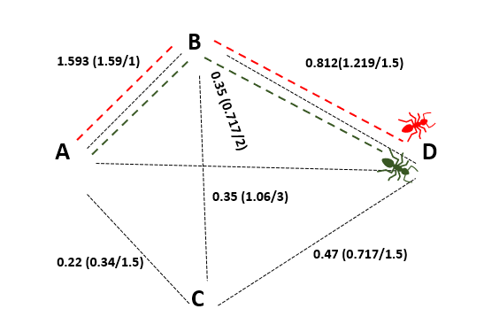
2 Ants
AB,BD
Path length : 2.5
Pheromone deposition : 1/2.5 (0.4)
AB,BD
Path length : 2.5
Pheromone deposition : 1/2.5 (0.4)
Edges
AB: 1; 1.62; (BD, BC)
AD: 3; 0.34; (---)
AC: 1.5; 0.73; (CD)
BD: 1.5; 1.219 (AB, CD)
CD: 1.5; 1.535; (---)
BC: 2; 0.34; (AC, AB, BD, CD)
Edges
AB: 1; 0.7*1.62+0.4+0.4; (BD, BC)
AD: 3; 0.7*0.34; (---)
AC: 1.5; 0.7*0.73; (CD)
BD: 1.5; 0.7*1.219+0.4+0.4 (AB, CD)
CD: 1.5; 0.7*1.535; (---)
BC: 2; 0.7*0.34; (AC, AB, BD, CD)
Edges
AB: 1; 1.93; (BD, BC)
AD: 3; 0.24; (---)
AC: 1.5; 0.511; (CD)
BD: 1.5; 1.65 (AB, CD)
CD: 1.5; 1.07; (---)
BC: 2; 0.24; (AC, AB, BD, CD)

Slide 122
INITIAL PHEROMONE LEVELS
AB: 1
AD: 1
AC: 1
BD: 1
CD: 1
BC: 1
FINAL PHEROMONE LEVELS
AB: 1.93
AD: 0.24
AC: 0.511
BD: 1.65
CD: 1.07
BC: 0.24

Slide 123

ACO – SHORTEST PATH PROBLEM
B
Edges:
AB
BD
AC
CD
AD
BC
CB
8
8
A
22
D
9
Name
Adjacent
Pheromone conc
Length
14
10
C

Slide 124
ACO – SHORTEST PATH PROBLEM
B
8
8
ab = ['AB',['BC','BD'],8,1]
A
22
D
9
14
10
C

Slide 125
ACO – SHORTEST PATH PROBLEM
B
8
8
ad = ['AD',[],22,1]
A
22
D
9
14
10
C

Slide 126
ACO – SHORTEST PATH PROBLEM
B
8
8
bc = ['BC',['CD’],9,1]
A
22
D
9
14
10
C

Slide 127
ACO – SHORTEST PATH PROBLEM
B
8
8
bd = ['BD',[],8,1]
A
22
D
9
14
10
C

Slide 128
ACO – SHORTEST PATH PROBLEM
B
8
8
ac = ['AC',[‘CB',’CD'],14,1]
A
22
D
9
14
10
C

Slide 129
ACO – SHORTEST PATH PROBLEM
B
8
8
cd = ['CD',[],10,1]
A
22
D
9
14
10
C

Slide 130
ACO – SHORTEST PATH PROBLEM
B
8
8
cb = ['CB',['BD'],9,1]
A
22
D
9
14
10
C

Slide 131
ACO – SHORTEST PATH PROBLEM
B
8
8
ab = ['AB',['BC','BD'],8,1]
ac = ['AC',['BC','BD'],14,1]
ad = ['AD',[],22,1]
bc = ['BC',['CD’],9,1]
cb = ['CB',['BD'],9,1]
bd = ['BD',[],8,1]
cd = ['CD',[],10,1]
A
22
D
9
14
10
C

Slide 132
Edge = [name, adjacent edges, length, pheromone level]
ab = ['AB',['BD','BE','BC'],5,1]
ac = ['AC',['CB','CD','CE'],6,1]
ae = ['AE',[],30,1]
bd = ['BD',['DE','DC'],6,1]
be = ['BE',[],16,1]
bc = ['BC',['CD','CE'],11,1]
cb = ['CB',['BD','BE'],11,1]
cd = ['CD',['DE'],17,1]
ce = ['CE',[],10,1]
de = ['DE',[],4,1]
dc = ['DC',['CE'],17,1]

Slide 133
ab = ['AB',['BD','BE','BC'],5,1]
ac = ['AC',['CB','CD','CE'],6,1]
ae = ['AE',[],30,1]
bd = ['BD',['DE','DC'],6,1]
be = ['BE',[],16,1]
bc = ['BC',['CD','CE'],11,1]
cb = ['CB',['BD','BE'],11,1]
cd = ['CD',['DE'],17,1]
ce = ['CE',[],10,1]
de = ['DE',[],4,1]
dc = ['DC',['CE'],17,1]
6
B
D
5
4
11
16
A
17
30
E
6
C
10

Slide 134
ab = ['AB',['BD','BE','BC'],5,1]
ac = ['AC',['CB','CD','CE'],6,1]
ae = ['AE',[],30,1]
bd = ['BD',['DE','DC'],6,1]
be = ['BE',[],16,1]
bc = ['BC',['CD','CE'],11,1]
cb = ['CB',['BD','BE'],11,1]
cd = ['CD',['DE'],17,1]
ce = ['CE',[],10,1]
de = ['DE',[],4,1]
dc = ['DC',['CE'],17,1]
6
B
D
5
4
11
16
A
17
30
E
6
C
10

Slide 135
ab = ['AB',['BD','BE','BC'],5,1]
ac = ['AC',['CB','CD','CE'],6,1]
ae = ['AE',[],30,1]
bd = ['BD',['DE','DC'],6,1]
be = ['BE',[],16,1]
bc = ['BC',['CD','CE'],11,1]
cb = ['CB',['BD','BE'],11,1]
cd = ['CD',['DE'],17,1]
ce = ['CE',[],10,1]
de = ['DE',[],4,1]
dc = ['DC',['CE'],17,1]
6
B
D
5
4
11
16
A
17
30
E
6
C
10

Slide 136
ab = ['AB',['BD','BE','BC'],5,1]
ac = ['AC',['CB','CD','CE'],6,1]
ae = ['AE',[],30,1]
bd = ['BD',['DE','DC'],6,1]
be = ['BE',[],16,1]
bc = ['BC',['CD','CE'],11,1]
cb = ['CB',['BD','BE'],11,1]
cd = ['CD',['DE'],17,1]
ce = ['CE',[],10,1]
de = ['DE',[],4,1]
dc = ['DC',['CE'],17,1]
6
B
D
5
4
11
16
A
17
30
E
6
C
10

Slide 137
ab = ['AB',['BD','BE','BC'],5,1]
ac = ['AC',['CB','CD','CE'],6,1]
ae = ['AE',[],30,1]
bd = ['BD',['DE’],6,1]
be = ['BE',[],16,1]
bc = ['BC',['CD','CE'],11,1]
cb = ['CB',['BD','BE'],11,1]
cd = ['CD',['DE'],17,1]
ce = ['CE',[],10,1]
de = ['DE',[],4,1]
dc = ['DC',['CE'],17,1]
6
B
D
5
4
11
16
A
17
30
E
6
C
10

Slide 138
ab = ['AB',['BD','BE','BC'],5,1]
ac = ['AC',['CB','CD','CE'],6,1]
ae = ['AE',[],30,1]
bd = ['BD',['DE','DC'],6,1]
be = ['BE',[],16,1]
bc = ['BC',['CD','CE'],11,1]
cb = ['CB',['BD','BE'],11,1]
cd = ['CD',['DE'],17,1]
ce = ['CE',[],10,1]
de = ['DE',[],4,1]
dc = ['DC',['CE'],17,1]
6
B
D
5
4
11
16
A
17
30
E
6
C
10

Slide 139
6
ab = ['AB',['BD','BE','BC'],5,1]
ac = ['AC',['CB','CD','CE'],6,1]
ae = ['AE',[],30,1]
bd = ['BD',['DE','DC'],6,1]
be = ['BE',[],16,1]
bc = ['BC',['CD','CE'],11,1]
cb = ['CB',['BD','BE'],11,1]
cd = ['CD',['DE'],17,1]
ce = ['CE',[],10,1]
de = ['DE',[],4,1]
dc = ['DC',['CE'],17,1]
B
D
5
4
11
16
17
A
30
E
6
C
10

Slide 140
6
ab = ['AB',['BD','BE','BC'],5,1]
ac = ['AC',['CB','CD','CE'],6,1]
ae = ['AE',[],30,1]
bd = ['BD',['DE','DC'],6,1]
be = ['BE',[],16,1]
bc = ['BC',['CD','CE'],11,1]
cb = ['CB',['BD','BE'],11,1]
cd = ['CD',['DE'],17,1]
ce = ['CE',[],10,1]
de = ['DE',[],4,1]
dc = ['DC',['CE'],17,1]
B
D
5
4
11
16
A
17
30
E
6
C
10

Slide 141
ab = ['AB',['BD','BE','BC'],5,1]
ac = ['AC',['CB','CD','CE'],6,1]
ae = ['AE',[],30,1]
bd = ['BD',['DE','DC'],6,1]
be = ['BE',[],16,1]
bc = ['BC',['CD','CE'],11,1]
cb = ['CB',['BD','BE'],11,1]
cd = ['CD',['DE'],17,1]
ce = ['CE',[],10,1]
de = ['DE',[],4,1]
dc = ['DC',['CE'],17,1]
6
B
D
5
4
11
16
A
17
30
E
6
C
10

Slide 142
ab = ['AB',['BD','BE','BC'],5,1]
ac = ['AC',['CB','CD','CE'],6,1]
ae = ['AE',[],30,1]
bd = ['BD',['DE','DC'],6,1]
be = ['BE',[],16,1]
bc = ['BC',['CD','CE'],11,1]
cb = ['CB',['BD','BE'],11,1]
cd = ['CD',['DE'],17,1]
ce = ['CE',[],10,1]
de = ['DE',[],4,1]
dc = ['DC',['CE'],17,1]
6
B
D
5
4
11
16
A
17
30
E
6
C
10

Slide 143
ab = ['AB',['BD','BE','BC'],5,1]
ac = ['AC',['CB','CD','CE'],6,1]
ae = ['AE',[],30,1]
bd = ['BD',['DE','DC'],6,1]
be = ['BE',[],16,1]
bc = ['BC',['CD','CE'],11,1]
cb = ['CB',['BD','BE'],11,1]
cd = ['CD',['DE'],17,1]
ce = ['CE',[],10,1]
de = ['DE',[],4,1]
dc = ['DC',['CE'],17,1]
6
B
D
5
4
11
16
A
17
30
E
6
C
10

Slide 144
ab = ['AB',['BD','BE','BC'],5,1]
ac = ['AC',['CB','CD','CE'],6,1]
ae = ['AE',[],30,1]
bd = ['BD',['DE','DC'],6,1]
be = ['BE',[],16,1]
bc = ['BC',['CD','CE'],11,1]
cb = ['CB',['BD','BE'],11,1]
cd = ['CD',['DE'],17,1]
ce = ['CE',[],10,1]
de = ['DE',[],4,1]
dc = ['DC',['CE'],17,1]
6
B
D
5
4
11
16
A
17
30
E
6
C
10

